Slide 1
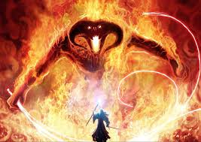
Book 2: the escape

Slide 2
Instructions:
The Balrog is after you, you must run!
Gimli knows the way out. However, being a dwarf, he gets his directions all messed up when he’s frightened.
He starts shouting where you need to go, but you start to doubt whether the instructions are formed correctly or not.
Choose the direction you think is correct and try to escape!

Slide 3
Make a left
Take a right

Slide 4
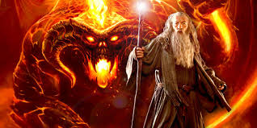
Too bad, try again!

Slide 5
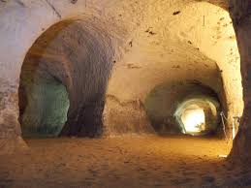
Go right ahead
Go straight ahead

Slide 6
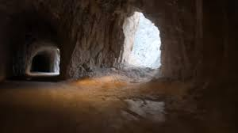
Take the dark tunnel on the right
Take the tunnel through the light
Take the tunnel next to the dark one

Slide 7
Take the tunnel to your right
Teek the tunnel to your left

Slide 8
Make through the top gap
Slide through the middle gap
Slide in the bottom gap

Slide 9
Jump through the bridge
Jump on top of the bridge
Jump over the bridge

Slide 10
Go back
Go through the door!!

Slide 11
Congratulations, you’ve made it out!

